Slide 1
Shell Bootcamp 2024 – TECHNICAL FOUNDATION Reflections for Day 6 (05-Sep-2024)
Hitesh
Date : - 06-Sep-2024

Slide 2

My learnings from this week!

Slide 3
Learning 1 | My takeaways
Cloud Computing
Cloud Computing is the delivery of computing services—including servers, storage, databases, networking, software, and analytics—over the internet ("the cloud"). This allows for flexible resources, faster innovation, and economies of scale, enabling users to access and pay for only the resources they need when they need them.
Key Characteristics of Cloud Computing
On-Demand Self-Service:
Users can provision computing resources like server time and storage as needed, without requiring human interaction with each service provider.
Example: A developer can instantly create a virtual server on AWS without contacting support.
Resource Pooling:
Cloud providers serve multiple customers from shared resources dynamically assigned and reassigned according to demand.
Example: A cloud data center hosts resources for multiple organizations, optimizing usage.
Broad Network Access:
Resources are accessible over the network via standard mechanisms, promoting use across a variety of devices (e.g., laptops, mobile phones).
Example: Google Drive can be accessed from any internet-connected device.
Rapid Elasticity:
Resources can be elastically provisioned and released to scale rapidly with demand, appearing unlimited to the user.
Example: An e-commerce website can scale up resources during high-traffic events like Black Friday.

Slide 4
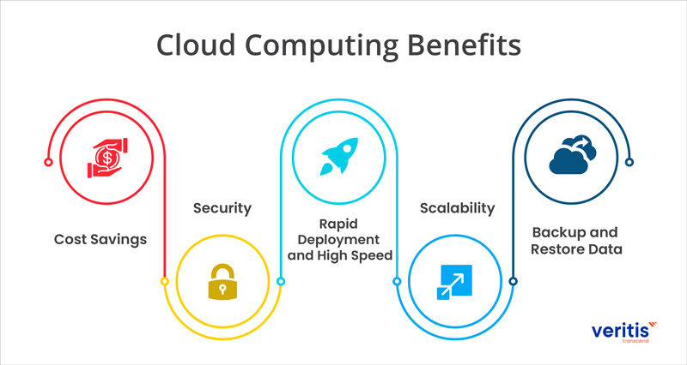
Learning 1 | My takeaways

Slide 5
Learning 2 | My takeaways
Benefits of Cloud Computing
Cost Efficiency:
Pay only for the resources used, reducing the need for large upfront investments.
Scalability:
Easily scale resources up or down based on demand.
Flexibility:
Access services from anywhere with an internet connection.
Disaster Recovery:
Automatic backups and recovery options ensure business continuity.
Automatic Updates:
Providers handle software updates, reducing maintenance work for users.
Cloud Service Models
IaaS (Infrastructure as a Service):
Provides fundamental computing resources like virtual machines, storage, and networks. Users manage the OS, storage, and applications, while the provider manages the infrastructure.
Example: AWS EC2, Microsoft Azure Virtual Machines, Google Cloud Compute Engine.
PaaS (Platform as a Service):
Offers a platform allowing customers to develop, run, and manage applications without dealing with the underlying infrastructure.
Example: Heroku, Google App Engine, Microsoft Azure App Services.
SaaS (Software as a Service):
Delivers software applications over the internet, on a subscription basis, fully managed by the provider.
Example: Google Workspace, Salesforce, MS Office 365.

Slide 6
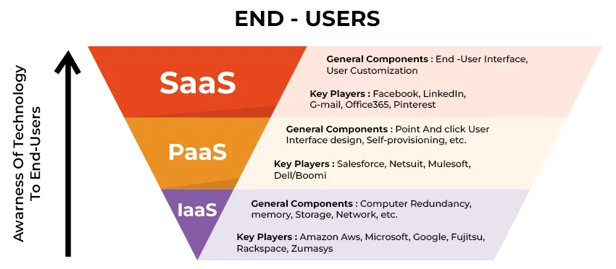
Learning 2 | My takeaways

Slide 7
Learning 3 | My takeaways
IaaS vs PaaS vs SaaS
IaaS:
User Manages: OS, applications, storage.
Provider Manages: Virtualization, servers, storage, networking.
Example: AWS EC2, Azure VMs.
PaaS:
User Manages: Applications and data.
Provider Manages: OS, middleware, runtime, servers, storage.
Example: Google App Engine, Heroku.
SaaS:
User Manages: Only application configuration.
Provider Manages: Everything else, including applications.
Example: Gmail, Slack, Dropbox.
Cloud Deployment Models
Public Cloud:
Services offered over the public internet and available to anyone who wants to purchase them.
Example: AWS, Microsoft Azure, Google Cloud.
Private Cloud:
Exclusive cloud environment dedicated to a single organization, offering more control and security.
Example: Internal cloud resources managed within a company’s own data center.
Hybrid Cloud:
Combines public and private clouds, allowing data and applications to be shared between them.
Example: An organization might use a private cloud for sensitive operations and a public cloud for less-critical resources.

Slide 8
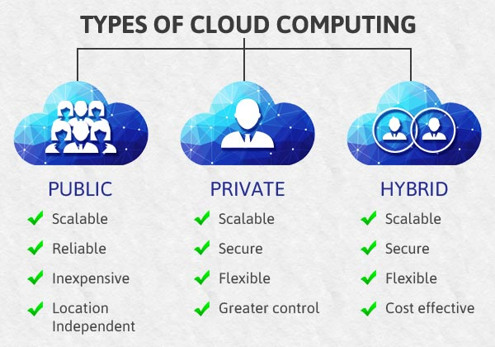
Learning 3 | My takeaways

Slide 9
Learning 4 | My takeaways
Community Cloud:
A shared cloud environment that serves a specific community with shared concerns, such as regulatory requirements.
Example: Government agencies with shared infrastructure.
Cloud Infrastructure Models
Virtualization:
The creation of virtual versions of physical resources, such as servers or storage, enabling flexible resource management.
Example: VMware vSphere.
Containers:
Lightweight virtualization that allows applications to run consistently across various environments by packaging code and dependencies together.
Example: Docker.
Serverless Computing:
A cloud-computing model where the cloud provider automatically manages the infrastructure, scaling resources up or down as needed.
Example: AWS Lambda.
Cloud Storage and Data Management
Object Storage:
Stores data as objects, each with its own unique identifier, suitable for unstructured data.
Example: Amazon S3, Google Cloud Storage.
Block Storage:
Data is stored in blocks, similar to traditional hard drives, providing high performance for databases.
Example: AWS EBS, Azure Disks.
File Storage:
Stores data in a hierarchical file system, suitable for shared file storage.
Example: Amazon EFS, Azure Files.

Slide 10
Learning 5 | My takeaways
Cloud Scalability and Elasticity
Scalability:
The ability to increase resources based on demand, either by scaling up (adding more power to an existing resource) or scaling out (adding more instances).
Example: Adding more virtual machines during high traffic.
Elasticity:
The ability to automatically adjust resources based on real-time demand, scaling both up and down.
Example: Automatically reducing server instances during off-peak hours.
Cloud Services
Compute Services:
Provide processing power and memory resources.
Example: AWS EC2, Google Compute Engine.
Storage Services:
Offer various data storage options such as object, block, or file storage.
Example: Amazon S3, Azure Blob Storage.
Networking Services:
Manage networking resources like VPNs, load balancers, and domain name systems.
Example: AWS VPC, Google Cloud Load Balancing.
Scalability and Flexibility
Scalability:
Allows organizations to scale resources up or down as needed, efficiently managing costs and performance.
Flexibility:
Provides the ability to choose the right mix of cloud services, enabling businesses to respond quickly to changing needs.

Slide 11
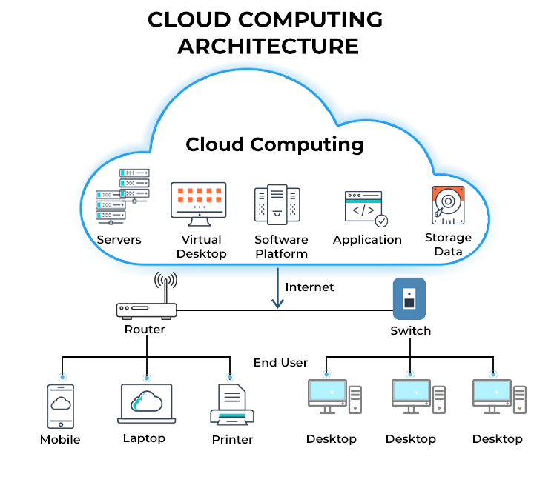
Learning 6 | My takeaways
Global Reach
Cloud providers offer services through data centers located worldwide, allowing businesses to deploy applications closer to users for better performance.
Example: AWS, Azure, and Google Cloud have data centers in multiple regions across the globe.

Slide 12
Thank You

